Slide 1
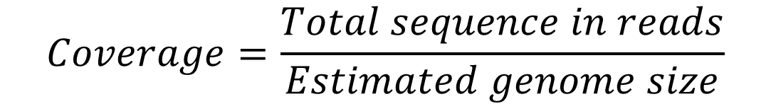
Coverage
Coverage refers to redundancy in sequencing data
Commonly expressed as <number>x, such as 20x, 30x, etc.
For paired reads one can compute coverage by reads and coverage by fragments
$$Coverage=\frac{Total sequence in reads}{Estimated genome size}$$
fragment or insert
read
AGATAGACATAGACATAGACAGATACACTCGATCG TCTATCTGTATCTGTATCTGTCTATGTGAGCTAGC
read

Slide 2
How much coverage is sufficient?
It depends… on read lengths
1x is enough if read length == chromosome length
In general read length << chromosome length
Problem: assume fixed read length << chromosome length
What is the probability of a gap?
Use Poisson distribution!

Slide 3
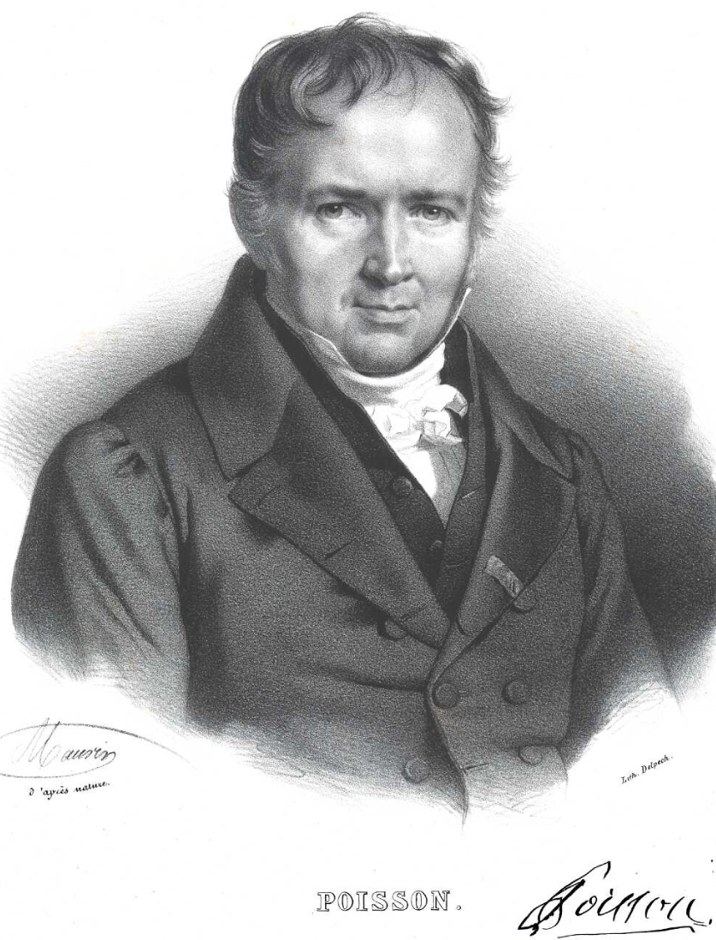
Poisson distribution
The Poisson distribution is a discrete probability distribution that expresses the probability of a given number of events occurring in a fixed interval of time if these events occur with a known constant mean rate and independently of the time since the last event.
Named after French mathematician Siméon Denis Poisson (1781–1840). Image credit:Wikipedia

Slide 4
Example of a Poisson process
For instance, consider a call center which receives an average of λ = 3 calls per minute at all times of day.
If the number of calls received in any two given disjoint time intervals is independent, then the number k of calls received during any minute has a Poisson probability distribution.
Can you come up with an example?

Slide 5
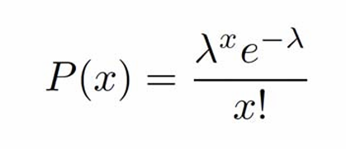
Poisson distribution
The Poisson distribution is also the limit of a binomial distribution, for which the probability of success for each trial p equals λ/n, as the number of trials n approaches infinity
Under a Poisson distribution with the expectation of λ events in a given interval, the probability of x events in the same interval is:

Slide 6
Poisson distribution and coverage
Let:
G genome length (in bp)
L read average length (L<<G)
N number of reads
Then:
λ, sequencing redundancy = N*L/G
x is the number of reads covering a given site on the genome
For a given base on the genome for each read Prob(base covered)=L/G << 1; number of attempts (reads): N >> 1.
Genome coverage λ = NL/G is O(1). x=2 x=4 x=0

Slide 7
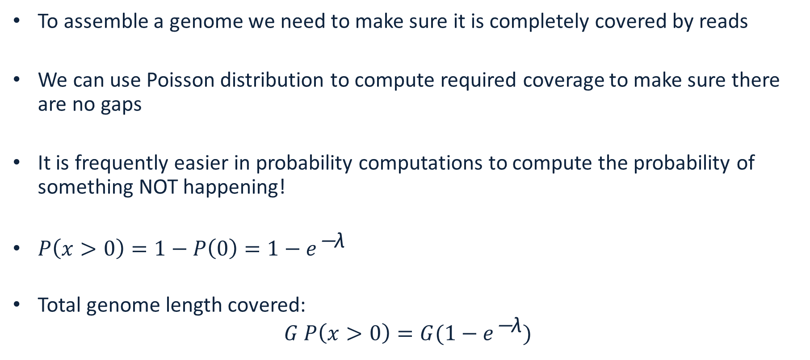
Fraction of the genome covered
To assemble a genome we need to make sure it is completely covered by reads
We can use Poisson distribution to compute required coverage to make sure there are no gaps
It is frequently easier in probability computations to compute the probability of something NOT happening!
${P\left(x>0\right)=1−P\left(0\right)=1−e}^{\text{−}\text{λ}}$
Total genome length covered: ${G P\left(x>0\right)=G(1−e}^{\text{−}\text{λ}})$

Slide 8
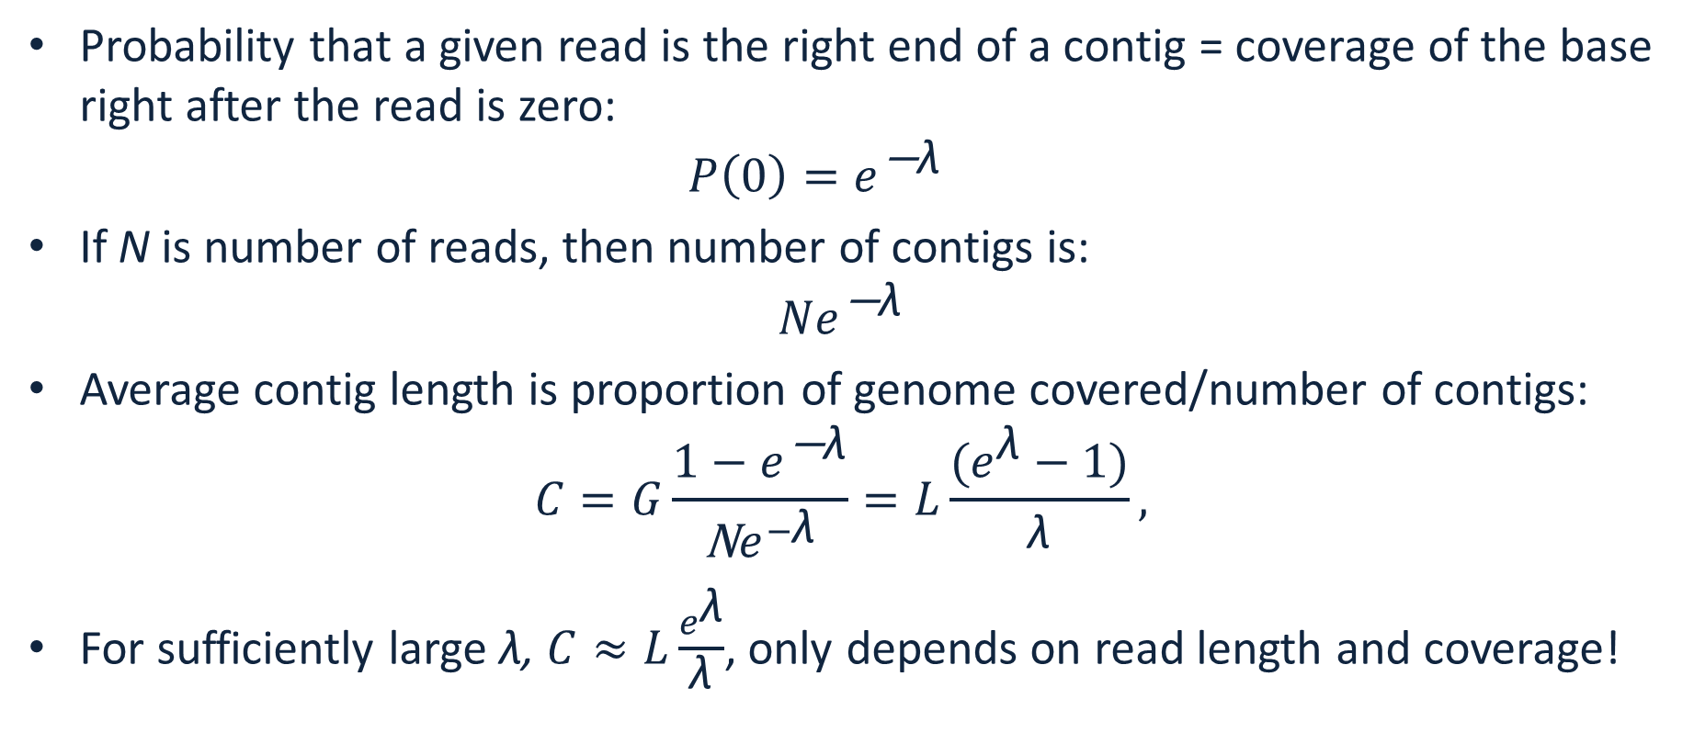
Number of contigs and average length
Probability that a given read is the right end of a contig = coverage of the base right after the read is zero: ${P\left(0\right)=e}^{\text{−}\text{λ}}$
If N is number of reads, then number of contigs is: ${Ne}^{\text{−}\text{λ}}$
Average contig length is proportion of genome covered/number of contigs: $C=G\frac{{1−e}^{\text{−}\text{λ}}}{\text{N}e^{−\text{λ}}}=L\frac{(e^{\text{λ}}−1)}{\text{λ}},$
For sufficiently large λ, $C≈L\frac{e^{\text{λ}}}{\text{λ}}$, only depends on read length and coverage!

